Slide 1

My Learning Journey with OCI Data Science Professional
Transforming theoretical knowledge into practical expertise through Oracle's comprehensive certification programme

Slide 2
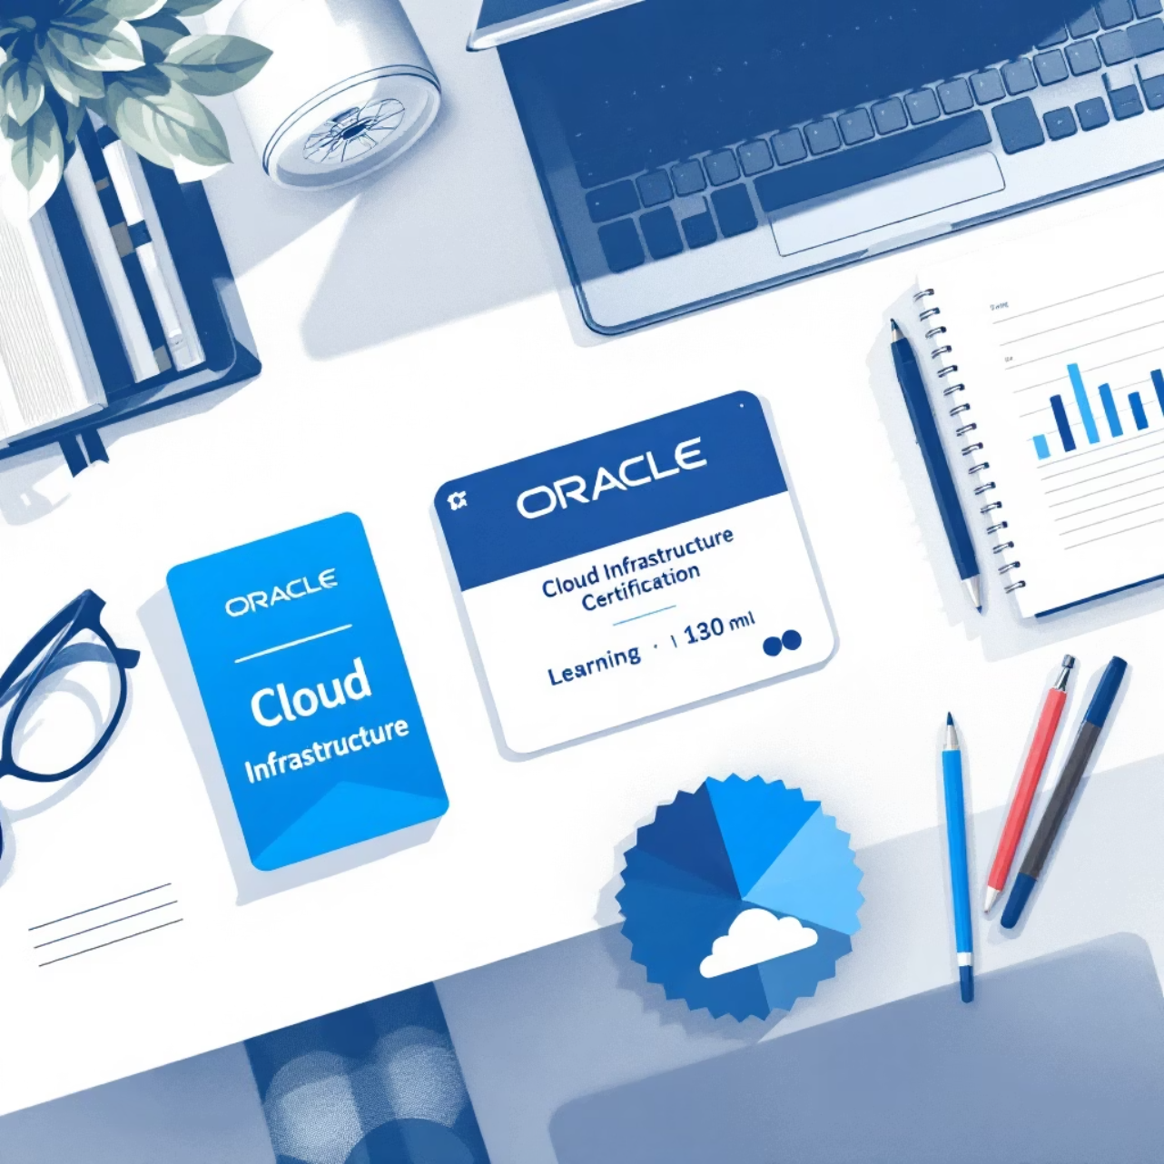
The Journey Begins
I recently completed the OCI Data Science Professional certification through Oracle's Race to Certification programme. This comprehensive journey provided hands-on understanding of the complete machine learning lifecycle on OCI.
From initial dataset preparation and model building to deployment and monitoring at enterprise scale, this certification equipped me with practical skills that bridge the gap between data science theory and real-world implementation.

Slide 3





Course Highlights & Core Learning Areas
Project Management
Model Development
MLOps Integration
Set up and managed projects within organised workspaces for efficient collaboration
Built, trained, and deployed sophisticated machine learning models at scale
Applied MLOps principles for automated model lifecycle management
Service Integration
Monitoring Strategy
Integrated with Vault, Object Storage, Data Flow, and Data Labelling services
Implemented comprehensive monitoring and model retraining strategies

Slide 4
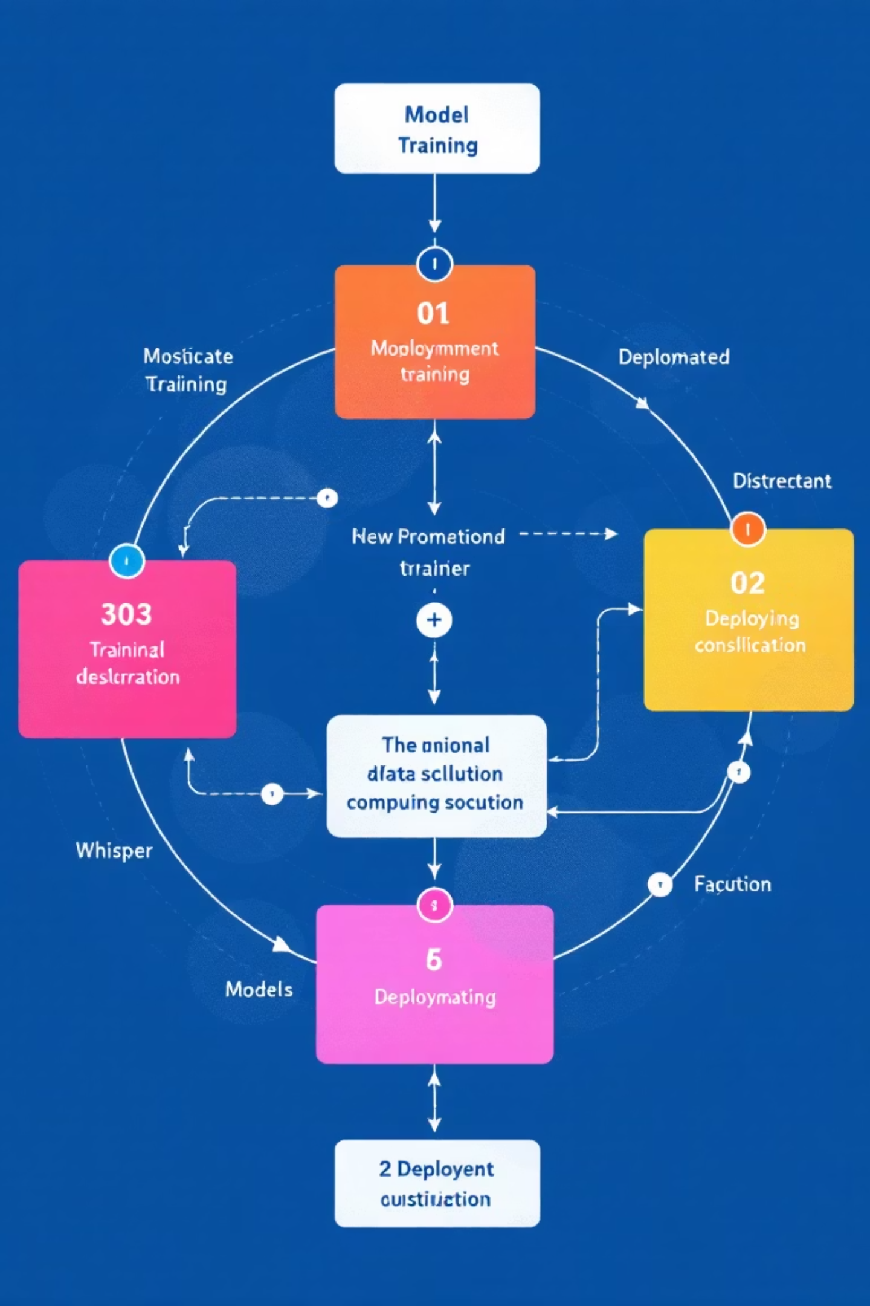
Practical Learnings: Technical Foundation
OCI Environment Mastery
Organised projects within structured workspaces for optimal workflow
1
Configured comprehensive IAM roles and security protocols
Leveraged ADS SDK for streamlined data handling and processing
Machine Learning Implementation
Executed data cleaning and transformation pipelines
2
Trained robust models using XGBoost and scikit-learn frameworks
Evaluated performance with ROC-AUC, precision, and recall metrics
Deployed scalable APIs for real-time prediction services

Slide 5




MLOps & Automation Excellence
Pipeline Creation
Developed automated pipelines for continuous model retraining and validation
Performance Monitoring
Implemented real-time monitoring with intelligent alerting systems
Version Management
Established comprehensive model versioning for reproducibility and rollback capabilities

Slide 6


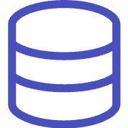

OCI Service Integrations
Vault Integration
Object Storage
Secured sensitive data and credentials through comprehensive secrets management, ensuring enterprise-grade security standards
Managed datasets and model artifacts with scalable cloud storage solutions for seamless data accessibility
Data Flow Processing
Data Labelling Service
Executed large-scale data preparation and transformation using distributed computing capabilities
Created high-quality, curated datasets through systematic data labelling and annotation processes

Slide 7

Best Practices & Professional Standards
Security Excellence
Applied comprehensive cloud security standards including IAM protocols and end-to-end encryption
Cost Optimisation
Balanced cost efficiency with scalability requirements for sustainable ML operations
Business Application
Solved real-world challenges including demand forecasting, customer churn analysis, and natural language processing

Slide 8

Impact & Future Applications
End-to-End Expertise
Operational Excellence
Gained confidence to build complete ML pipelines from conception to production deployment
Mastered automated retraining and monitoring systems for enterprise-grade solutions
Business Value
Ready to apply ML solutions to diverse business use cases with measurable impact
Technical Arsenal: OCI Data Science Workspaces, ADS SDK, XGBoost, scikit-learn, OCI Vault, Object Storage, Data Flow, Data Labelling, OCI Logging & Monitoring, REST APIs

